Slide 1


Atliq hospitality Analysis

Slide 2

introduction
The dataset of Atliq Hospitality provided three months data for their restaurants in different cities. The given data for May, June & July. In the dataset, there is information about restaurant or hotel booking, check in and check out date, revenues and booking date etc. With the data we analyzed and made KPIs and also made infographics according to client’s needs using Power BI.

Slide 3
Techniques used
Load Dataset as CSV format
Used DAX query to calculate the total bookings, percent of occupancy and revenues.
Finally show graphs in dashboard using Power BI.

Slide 4

Business Problem
Total Revenues
Occupancy Percentage of Capacity
Average Ratings
Weekly Trends
Occupancy by Day Type ( Weekdays & Weekends )
Hotel Booking % by Platforms

Slide 5
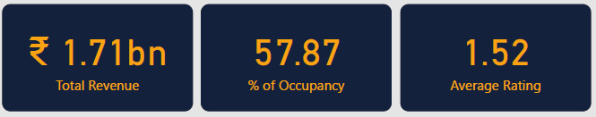
Solution : total revenues, % of occupancy & average rating
We can see the Total Revenues, % of Occupancy and Average Rating through KPIs cards in dashboard. Here the KPIs are : 1. Total Revenues : Rs. 1.71 bn
2. % of Occupancy : 57.87
3. Average Hotel Ratings : 1.52

Slide 6
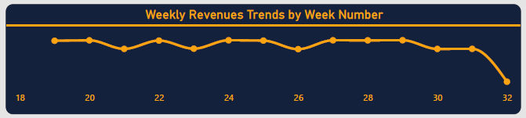
Solution : Weekly trends
In the above graph, we can see the weekly trends of revenues of Atliq Hospitality.
We observe that, during the week – 19, 20, 22, 24, 25, 27, 28 and 29 the revenues were higher than other weeks

Slide 7
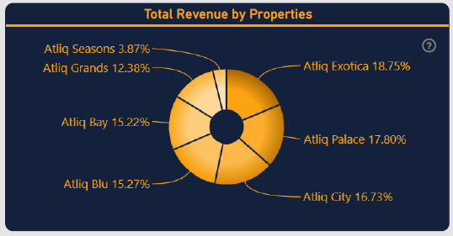
Solution : total revenues by property
In the Donut Chart, we can observe that, Atliq Exotica had the most revenues, which was 18.75 %. The other properties had less revenues than Atliq Exotica.
Other properties revenues share were : Atliq Palace : 17.80 %
Atliq City : 16.73 %
Atliq Blu : 15.27 %
Atliq Bay : 15.22 %
Atliq Grands : 12.38 %
Atliq Seasons : 3.87 %
Here, Atliq Seasons had least revenue shares in Atliq Hospitality.

Slide 8
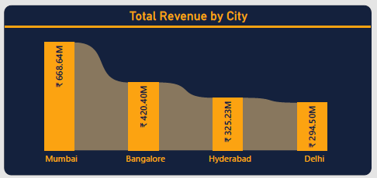
Solution : total revenues by city
In the above graph we can observe the total revenues by cities. Here, Mumbai had the highest revenue amount ( Approx. Rs. 668.64 M ).
Other cities – Bangalore, Hyderabad and Delhi had revenues Rs. 420.40 M, Rs. 325.23 M and Rs. 294.50 M respectively.

Slide 9
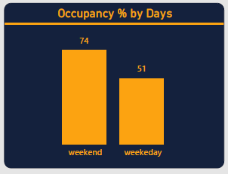
Solution : % of occupancy by days
In the above graph, we can observe that, weekend has more occupancy percentage that weekdays, which is quite obvious. During weekends, people travel their favourite cities or places due to holiday from their works. Weekend had 74 % occupancy, where as Weekdays had 51 % occupancy.

Slide 10
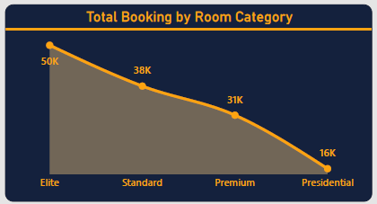
Solution : bookings by room category
In the above graph, we can observe that, Elite class rooms were booked more than other classes, which was 50K. So, we can say Elite class room is the most popular among travellers.
Where as Standard, Premium and Presidential rooms were booked – 38K, 31K and 16K respectively. Here, Presidential class room is least popular. Probably the high cost of Presidential room is the reason.

Slide 11
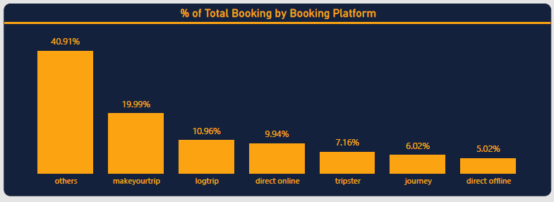
Solution : % of Booking by booking platform
In the above graph, we can observe that, “Others” booking platform category had the 40.91 % share of bookings, which was more than all other options.
Among bookings by travel brand, “Makeyourtrip” booking platform had the 19.99 % booking share, which was the most. Direct Offline had the least booking percentage.

Slide 12
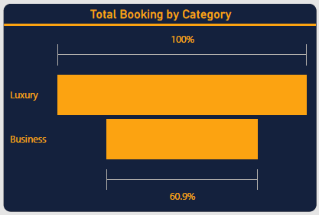
Solution : bookings by category
There is two types of booking categories : Luxury and Business.
Between them Luxury had the most booking share percentage than Business.
Probably the high cost of Business category, it had low percentage of booking.

Slide 13
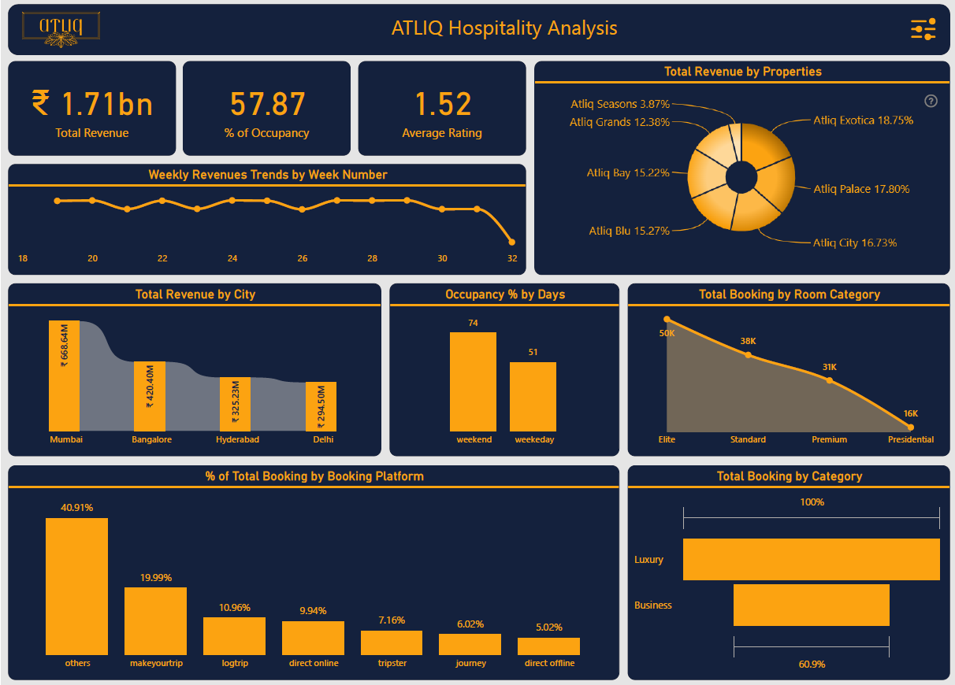
DASHBOARD

Slide 14
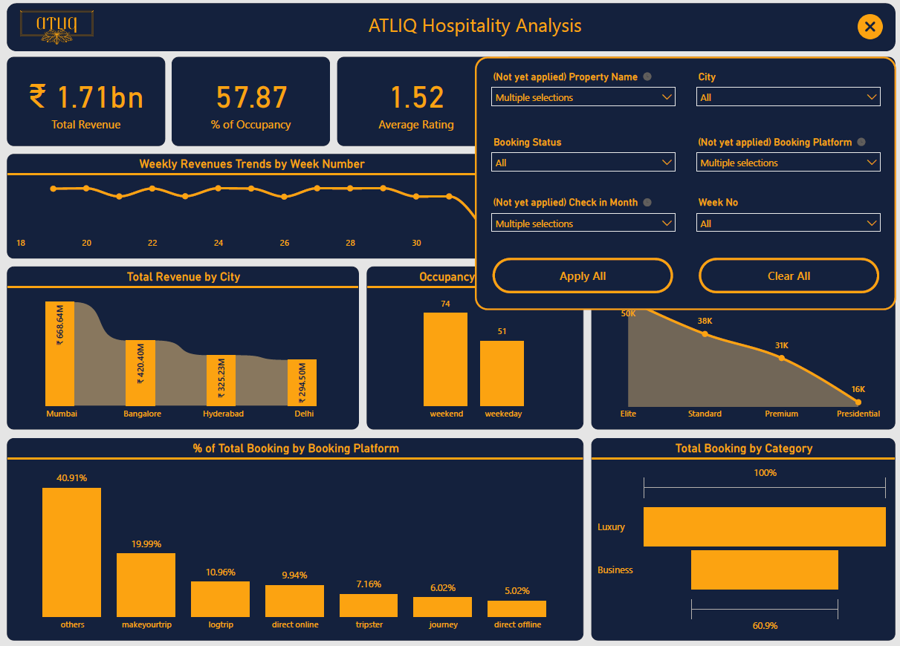
DASHBOARD with filter

Slide 15
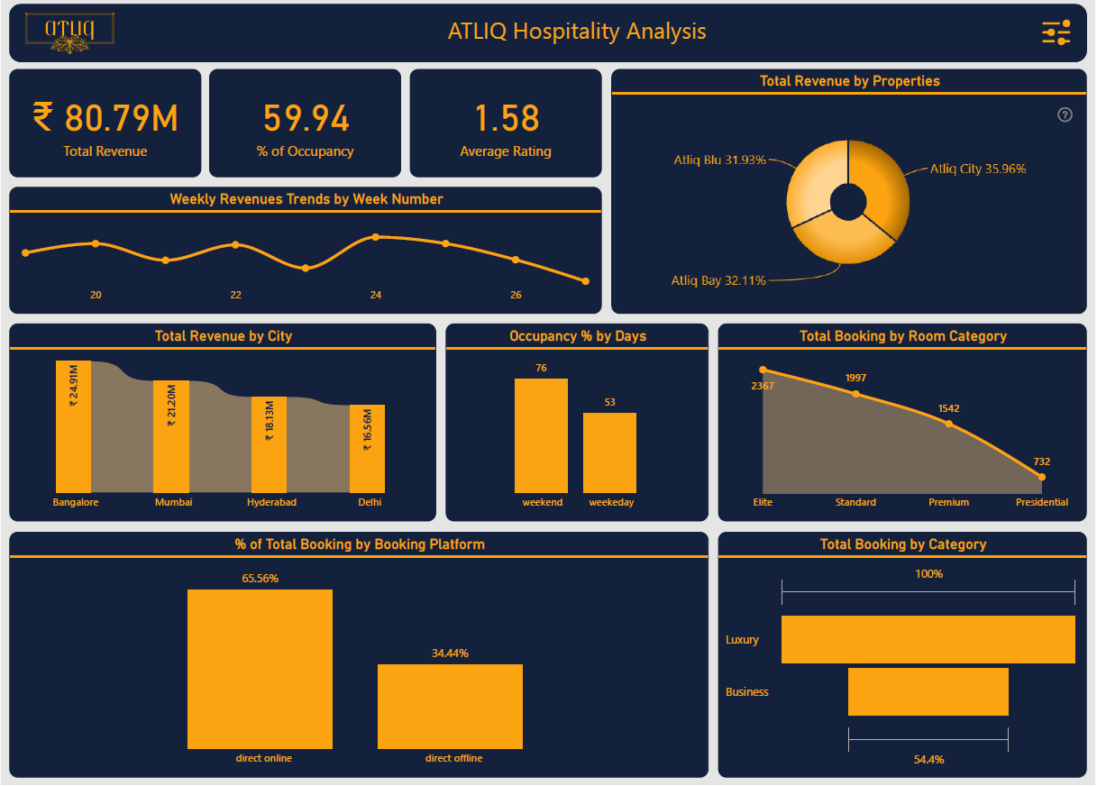
DASHBOARD after filter apply

Slide 16

Summary
From the data analysis of Atliq Hospitality, we observed that –
Atliq Exotica had highest revenues
Mumbai city had the highest revenues
Weekend had the most occupancy percentage
Elite room category had the most number of bookings
Luxury rooms had most booking than Business

Slide 17

Thank You
Akashdeep Dam​​
akashdeepdam@gmail.com
UNID : UMIP20537

